Slide 1
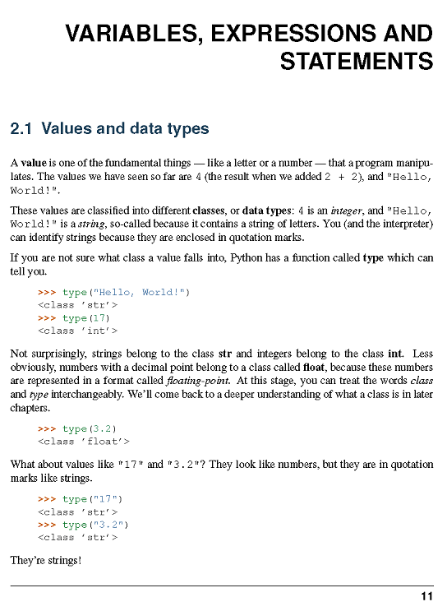

Slide 2
>>> type("Hello, World!")
<class ’str’>
>>> type(17)
<class ’int’>
>>> type(3.2)
<class ’float’>
What about values like "17“
>>> type("17")
<class ’str’>
>>> type("3.2")
<class ’str’>
type(3)
type(3.0)
type('3')
type('hello world')
type([1,2,3])
type((1,2,3))

Slide 3
**************************
WS Ch 2_1
What is the resulting data type when an int and a float are added?
**************************
Float

Slide 4
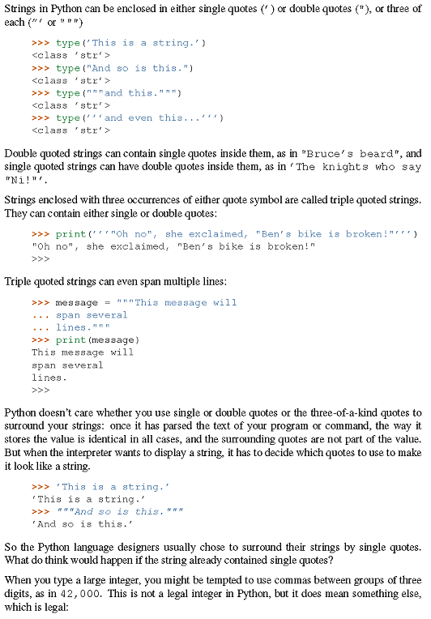

Slide 5
>>> type(’This is a string.’)
<class ’str’>
>>> type("And so is this.")
<class ’str’>
>>> type("""and this.""")
<class ’str’>
>>> type(’’’and even this...’’’)
<class ’str’>
>>> print(’’’"Oh no", she exclaimed, "Ben’s bike is broken!"’’’)
"Oh no", she exclaimed, "Ben’s bike is broken!"
>>> message = """This message will
... span several
... lines."""
>>> print(message)
This message will
span several
lines.
>>> ’This is a string.’
’This is a string.’
>>> """And so is this."""
’And so is this.’

Slide 6
********************************************
WS Ch2_2
Use print to print out the following strings:
What's the big idea?
"What's the big idea?", she said.
**********************************************
print(''' "What's the big deal?", she said.''')

Slide 7
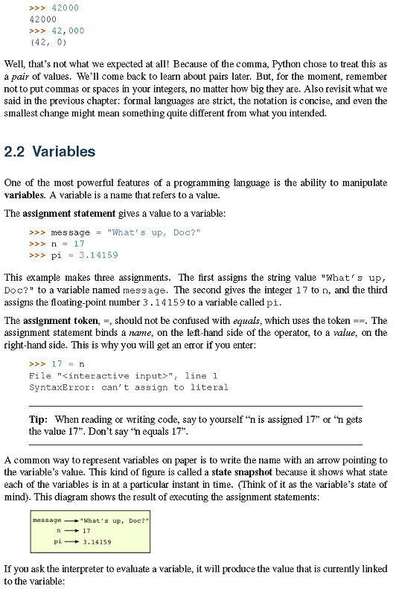

Slide 8
*********************************
WS ch2_3
What does Python do with the following?
x = 1
x = x + 1
y = 20
y = y/2
z = 34
z = z * 2
w = 45
w = w - 3
**********************************
For the first one assigns 1 to x and then evaluates (1)+1 and assigns the result to x. So x is 2.
The second one assigns 20 to y and then evaluates (20)/2 and then assign the result to y. y would be 10.
The third one would assign 34 to z and then evaluate (34)*2 and the result would be assigned to z. z would be 68.
The last one would assign 45 to w and then evaluate
(45) – 3 and assign the result to w. w would be 42.

Slide 9
>>> 42000
42000
>>> 42,000
(42, 0)
>>> message = "What’s up, Doc?"
>>> n = 17
>>> pi = 3.14159
>>> 17 = n
File "<interactive input>", line 1
SyntaxError: can’t assign to literal

Slide 10
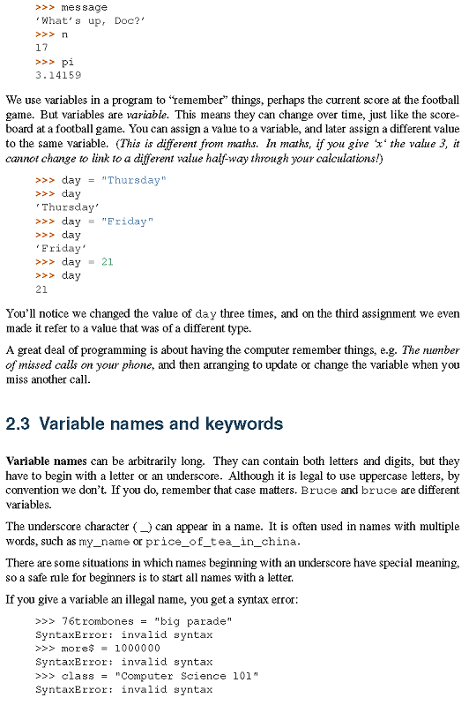

Slide 11
>>> message
’What’s up, Doc?’
>>> n
17
>>> pi
3.14159
>>> day = "Thursday"
>>> day
’Thursday’
>>> day = "Friday"
>>> day
’Friday’
>>> day = 21
>>> day
21

Slide 12
*******************************************
WS ch2_4
What does Python do with:
x,y,z = 1,2,3
x = x + 5
x = y * 4
z = z - 2
*******************************************
I will assign the variable x,y,z the corresponding int from left to right:
x would be assigned 1, y would be assigned 2, and x would be 3.
The first problem would be evaluated like so (1)+5 and the result 6 would be assigned to x. x is now 6.
The second problem would evaluate (2)*4 and our result would be 6. Then python would assign 6 to x. x is now 6.
The third problem evaluate (3) – 2 and our result would be 1. Then python would assign 1 to z. z is now 1.

Slide 13
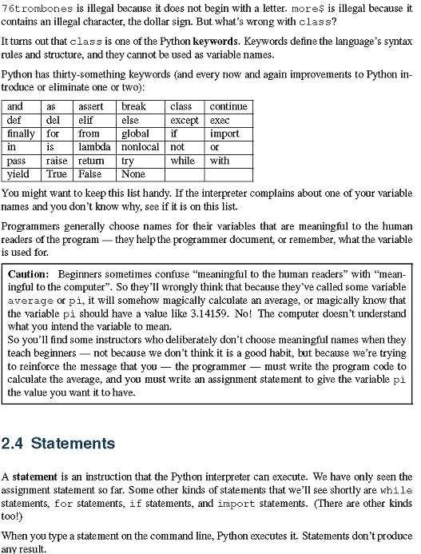

Slide 14
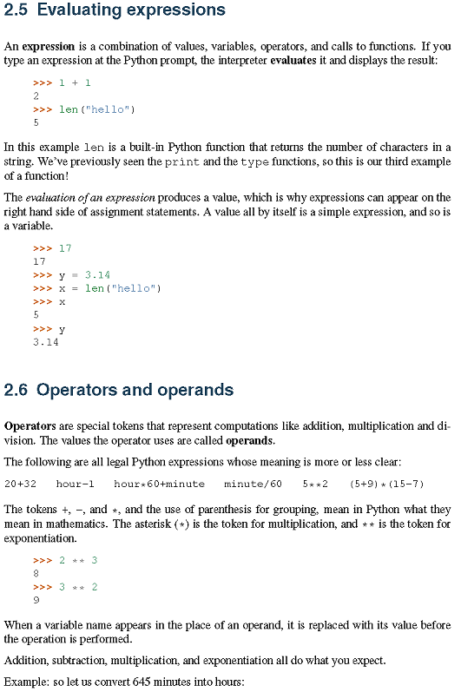

Slide 15
>>> 1 + 1
2
>>> len("hello")
5
>>> 17
17
>>> y = 3.14
>>> x = len("hello")
>>> x
5
>>> y
3.14
>>> 2 ** 3
8
>>> 3 ** 2
9

Slide 16
************************************
WS ch 2_5 : Predict the result of evaluating the following expressions:
x = (3 + 2) **2 + 1
x
x = x/2
x
2. a = 2
b = 3
x = 4*(b – a)
x
a = a + 1
b = b – 1
x
************************************
1) x = (3+2)**2+1
x = (5)*2+1
x = 25+1
x = 26
2) x = 4*(b - a) , a = 2 , b = 3
x = 4*((3) - (2))
x = 4*(1)
x = 4
a = a +1 , a = 2
a = (2)+1
a = 3
b = b - 1 , b = 3
b = (3) -1
b = 2
x = 26

Slide 17
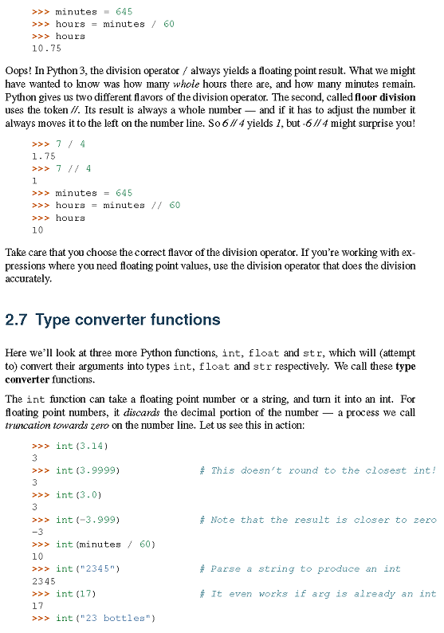

Slide 18
>>> minutes = 645
>>> hours = minutes / 60
>>> hours
10.75
>>> 7 / 4
1.75
>>> 7 // 4
1
>>> minutes = 645
>>> hours = minutes // 60
>>> hours
10
>>> int(3.14)
3
>>> int(3.9999) # This doesn’t round to the closest int!
3
>>> int(3.0)
3
>>> int(-3.999) # Note that the result is closer to zero
-3
>>> int(minutes / 60)
10
>>> int("2345") # Parse a string to produce an int
2345
>>> int(17) # It even works if arg is already an int
17
>>> int("23 bottles")

Slide 19
************************************
WS ch 2_6
Use the // operator to convert 8911 minutes to days, hours and minutes. (Later, we will meet the modulus operator which can also
be used.)
************************************
minutes = 8911
days = minutes // 1440
hours = (minutes - (days * 1440)) // 60
minute = minutes % 60
print("There are", days, "days", hours, "hours and", minute, "minutes in", minutes, "minutes.\n")
OOP Version:
class MinToDaysHoursMinutes:
def __init__(self,):
self.mins = int(input("How many minutes do you wish to convert: "))
self.min = 0
self.hours = 0
self.days = 0
def MinToDay(self):
self.days = self.mins // 1440
return self.days
def MinToHours(self):
self.hours = (self.mins-(self.days * 1440)) // 60
return self.hours
def MinToMins(self):
self.min = self.mins % 60
return self.min
def toString(self):
if self.mins == 1:
return print("\nThere are", self.MinToDay(), "days", self.MinToHours(), "hours and",
self.MinToMins(), "minute in", self.mins, "minute.")
elif self.MinToMins() == 1:
return print("\nThere are", self.MinToDay(), "days", self.MinToHours(), "hours and",
self.MinToMins(), "minute in", self.mins, "minutes.")
else:
return print("\nThere are", self.MinToDay(), "days", self.MinToHours(), "hours and",
self.MinToMins(), "minutes in", self.mins, "minutes.")
example_a = MinToDaysHoursMinutes()
example_a.toString()

Slide 20
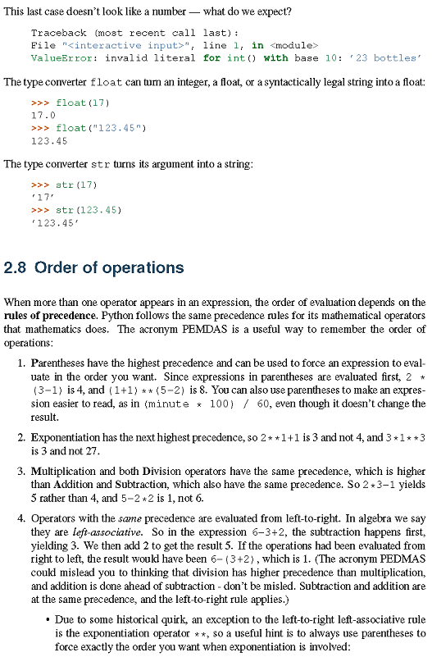

Slide 21
>>> float(17)
17.0
>>> float("123.45")
123.45
>>> str(17)
’17’
>>> str(123.45)
’123.45’

Slide 22
************************************
WS ch 2_7
How could you find the number of digits in an arbitrary integer?
Assume that the integer in question has been assigned to n.
For example, without counting the digits by hand, how many
Digits are there in
n = 10837645697820775994467843245679991239087567806632
************************************
>>> n = 10837645697820775994467843245679991239087567806632
>>> n = str(n)
>>> len(n)
Output: 50

Slide 23
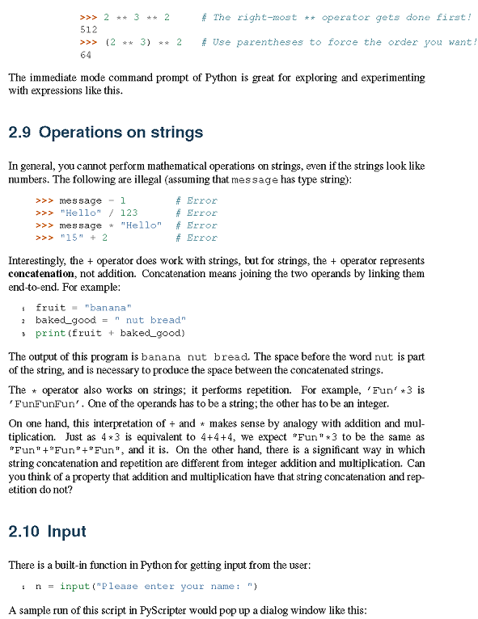

Slide 24
>>> 2 ** 3 ** 2 # The right-most ** operator gets done first!
512
>>> (2 ** 3) ** 2 # Use parentheses to force the order you want!
64
>>> message - 1 # Error
>>> "Hello" / 123 # Error
>>> message * "Hello" # Error
>>> "15" + 2 # Error
>>> ’Fun’*3
>>> "Fun"+"Fun"+"Fun”
fruit = "banana"
baked_good = " nut bread"
print(fruit + baked_good)
n = input("Please enter your name: ")

Slide 25
************************************
WS ch 2_8
Predict the result of evaluating:
n = len(‘two’)
strg = ‘peanut butter’ + ‘ & ‘ + ‘jelly’
strg
strg*n
************************************
The output would be:
peanut butter & jelly
peanut butter & jelly
peanut butter & jelly
peanut butter & jelly
This is because the result of len(‘two’) is three because two is three letters long. strg*n would be the same as strg*3 and that would print the string 3 times.

Slide 26
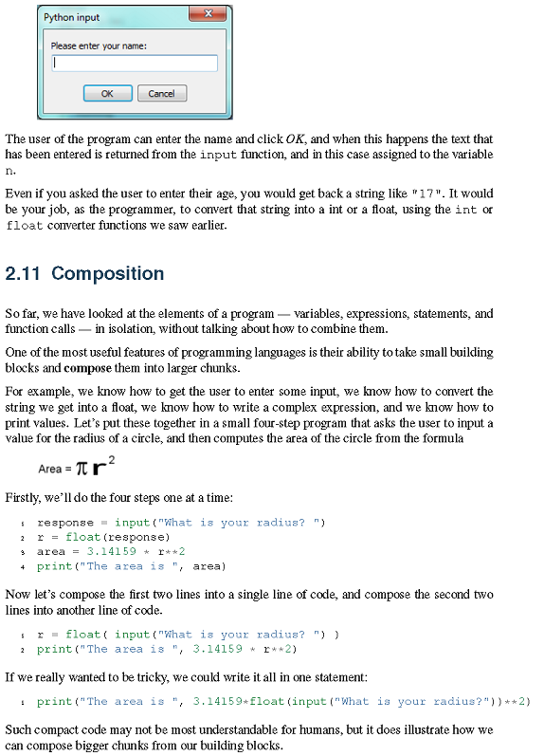

Slide 27
response = input("What is your radius? ")
r = float(response)
area = 3.14159 * r**2
print("The area is ", area)
r = float( input("What is your radius? ") )
print("The area is ", 3.14159 * r**2)
1 print("The area is ", 3.14159*float(input("What is your radius?"))**2)

Slide 28
*****************************
WS ch2_9
Get a user’s name, then ask the user using that name to provide
The radius of a circle. Then, print out the user’s name & the
Circumference of the circle.
*********************************
import math
name = input("What should I call you: ")
radius = input("Hello " + name + " what is the radius of your circle: ")
circumference = (2*math.pi*int(radius))
print("Ok", name, "that means the circumference of your circle with a radius of", radius, "is", circumference)

Slide 29
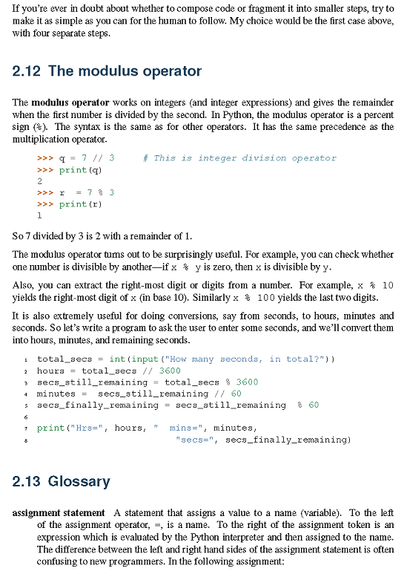

Slide 30
>>> q = 7 // 3 # This is integer division operator
>>> print(q)
2
>>> r = 7 % 3
>>> print(r)
1
total_secs = int(input("How many seconds, in total?"))
hours = total_secs // 3600
secs_still_remaining = total_secs % 3600
minutes = secs_still_remaining // 60
secs_finally_remaining = secs_still_remaining % 60
print("Hrs=", hours, " mins=", minutes,
"secs=", secs_finally_remaining)

Slide 31
*************************************
WS ch2_10
You leave for vacation on Friday & return 123 days later. Use // and % to compute the number of weeks gone and number of days after Friday that you returned. What day did you return?
**************************************
vacation = 123
weeksGone = vacation // 7
daysAfterFriday = vacation % 7
print("If you leave for", vacation, "days after Friday. You have been gone for", weeksGone, "weeks and will return",
daysAfterFriday, "after friday.")

Slide 32
## for loop & range
## repetition
## i is the loop variable
## i is not used inside loop
## goes thru loop 3 times
## i takes on the values 0,1,2
for i in range(3):
print('Hello!')
Hello!
Hello!
Hello!
## ## i is the loop variable
## i is used inside loop
for i in range(3):
print(i)
0
1
2
for i in range(3):
print(i**2)
0
1
4

Slide 33
for i in range(3):
print(i**.5)
0.0
1.0
1.4142135623730951
## by default, range starts at 0
## range's start can be overiden with a second parameter
for num in range(1,4):
print(num)
1
2
3
## by default, range increases the loop variable by
## range's increment can be overiden with a third parameter
for number in range(1,10,2):
print(number)
1
3
5
7
9

Slide 34
*************************************
WS ch2_11
Use a for loop with range to print out table of numbers for the
Square and cube of integers from 1 to 10. The first column should have the number, the second column will have the square of the number and the third column will have the cube.
**************************************
print("Num", " ", "Squared", " ", "Cubed")
for i in range(1, 11):
print(i, " ", (i**2), " ", (i**3))
*************************************
WS ch2_12
Use a for loop with range to sum all the odd numbers from 11 to 91. Use a sum accumulator.
**************************************
sum = 0
for i in range(11,92,2):
sum = sum + i
print(sum)

Slide 35
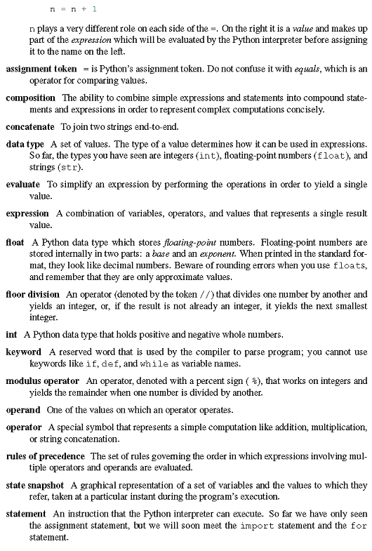

Slide 36
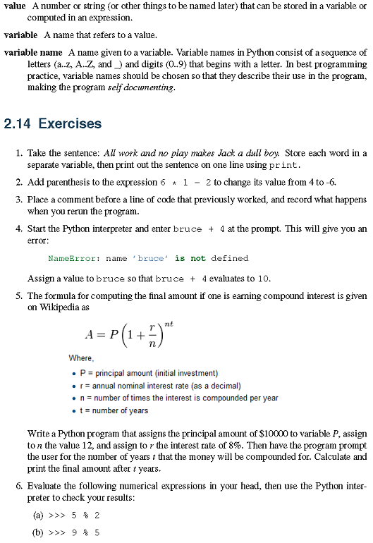

Slide 37
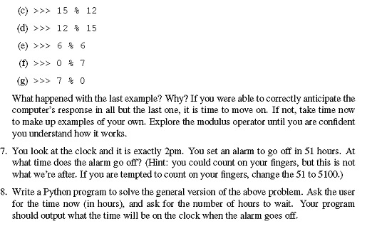

Slide 38
HW for Ch 2:
1,3,4,6,7
Youtube HW:
5

